Slide 1
Final Year Project Report

Slide 2
Project background and Introduction
Fundamental knowledge
Current situation of the students lacking computer knowledge

Slide 3
Objective of the project
Develop simple informative website
Help students to understand how the computers work

Slide 4
Scopes of the project
Forum
Quiz
FAQs

Slide 5
Problem Statement
More and more students are lacking computer knowledge

Slide 6
Literature Review
Why should they learn computer knowledge
Insufficient up-to-date computer in schools
How good is an informative website
Actions done by Malaysia government to deal with current situation

Slide 7
Thesis statement
Will the current situation of students lacking computer knowledge be enriched by a simple informative website and how does it help in their current and future study?

Slide 8
Project plans and methodology
Waterfall methodology
Preparations

Slide 9
Project plans and methodology (requirements gathering)
Functional Requirements
Allow users to do something
Non-functional Requirements
System requirements

Slide 10
Project plans and methodology (design and implementation)
Functional specification
Who are you?
Why do you need a website?
Who is your key audience?
How should your site be organized?
How does it work?
Who are your competitors?
What is your budget and deadline?

Slide 11
Project plans and methodology (design and implementation)
Hardware
Desktop computer
Testing will be done with other device
Software
Pencil, Microsoft Word/Project/Edge
Visual Studio Code, NetBeans IDE
Different Web Broswers

Slide 12
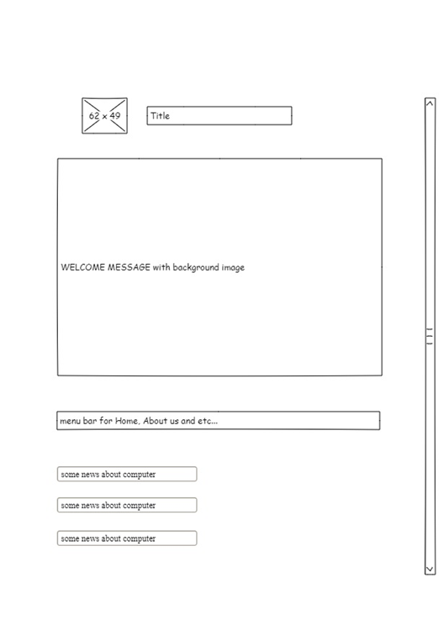
Project plans and methodology (design and implementation)
Basic layout of the website

Slide 13
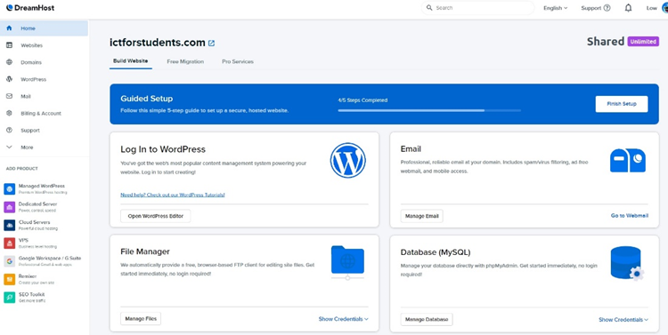
Project plans and methodology (design and implementation)
Interface of Dreamhost

Slide 14
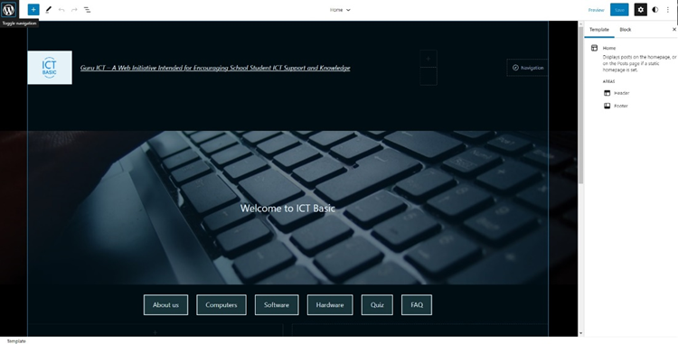
Project plans and methodology (design and implementation)
Interface of the website done with WordPress

Slide 15
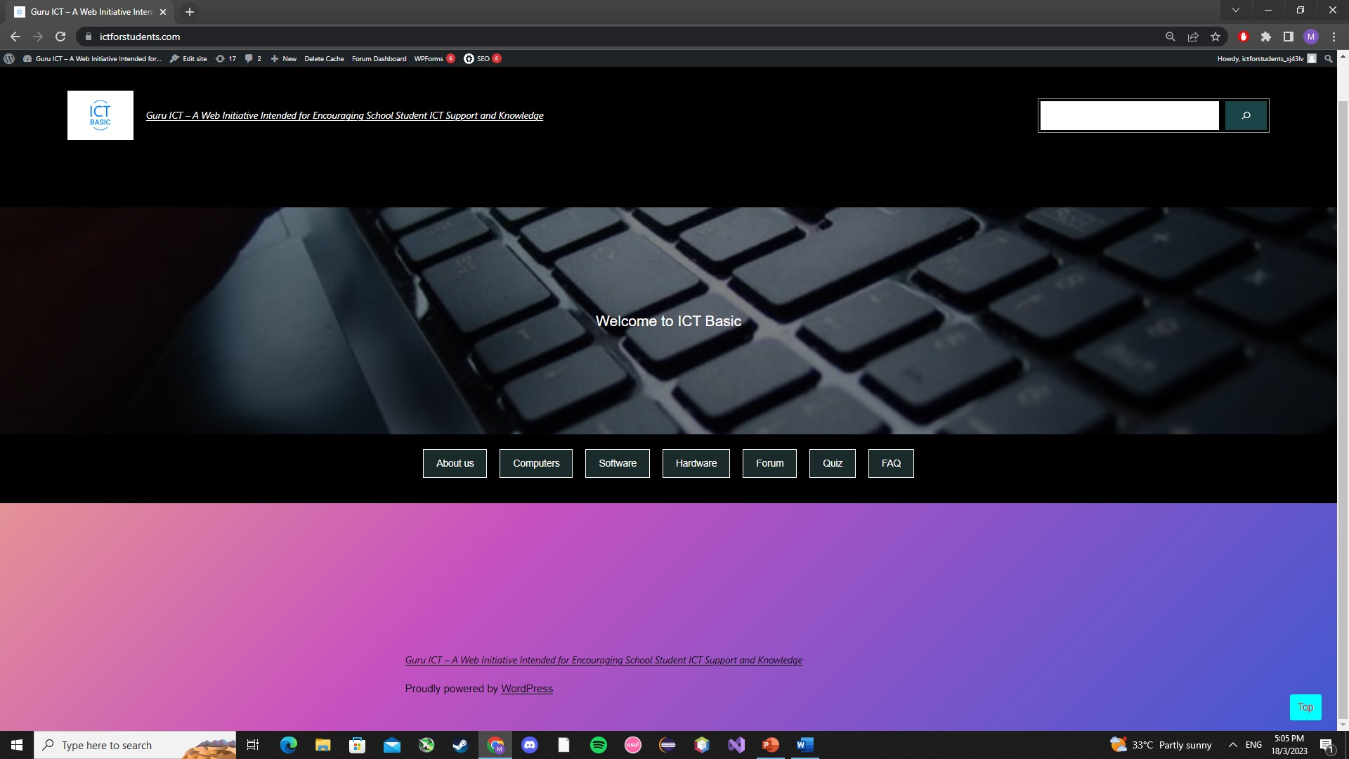

Project plans and methodology (design and implementation)
Back to top button
Back to top button in a website

Slide 16
Project plans and methodology (design and implementation)
Creating a back to top button
if (document.body.scrollTop > 20 || document.documentElement.scrollTop > 20) {
mybutton.style.display = "block";
} else {
mybutton.style.display = "none";
}

Slide 17
Project plans and methodology (design and implementation)
Styling the back to top button
#myBtn{ display:none; position:fixed; background-color:aqua; color:red; etc….

Slide 18
Project plans and methodology (design and implementation)
Styling the back to top button
#myBtn{ display:none; position:fixed; background-color:aqua; color:red; etc….

Slide 19

Project plans and methodology (design and implementation)
Search bar

Slide 20
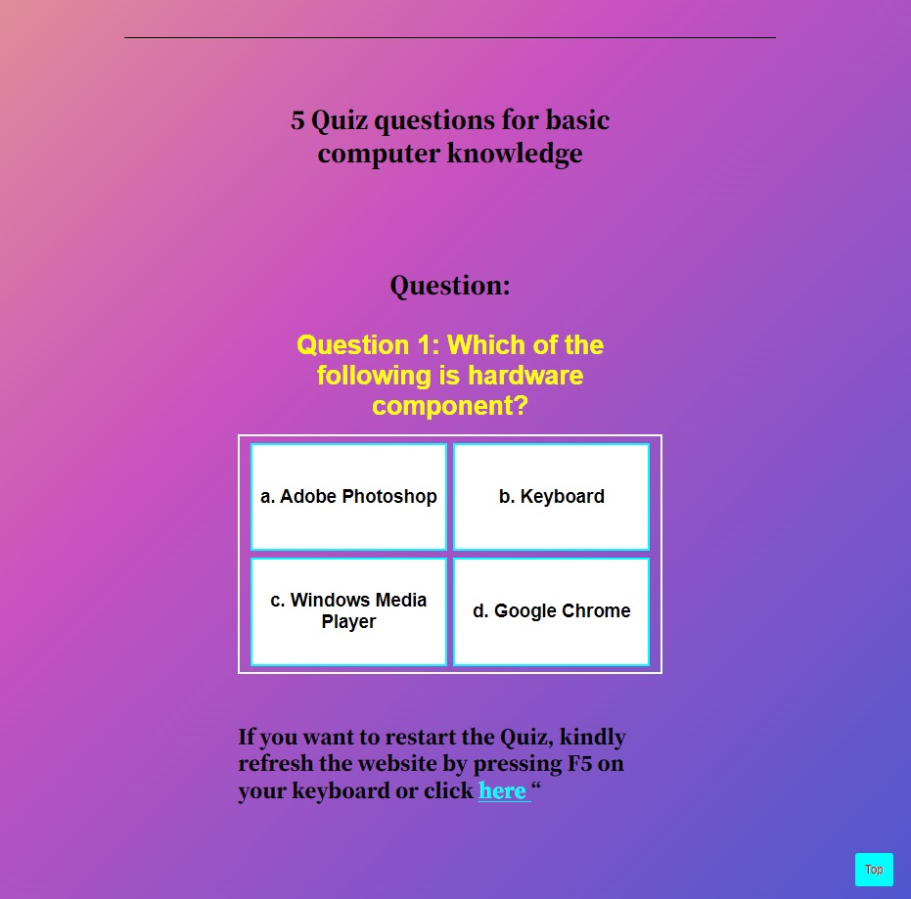
Project plans and methodology (design and implementation)
Creating a page for Quiz

Slide 21
Project plans and methodology (design and implementation)
x Questions will be selected randomly from a list of questions each time the quiz is restarted
const randomQuestions = questions
.sort(() => 0.5 - Math.random())
.slice(0, x);
To choose 5 questions randomly from the list, I can replace x with 5

Slide 22
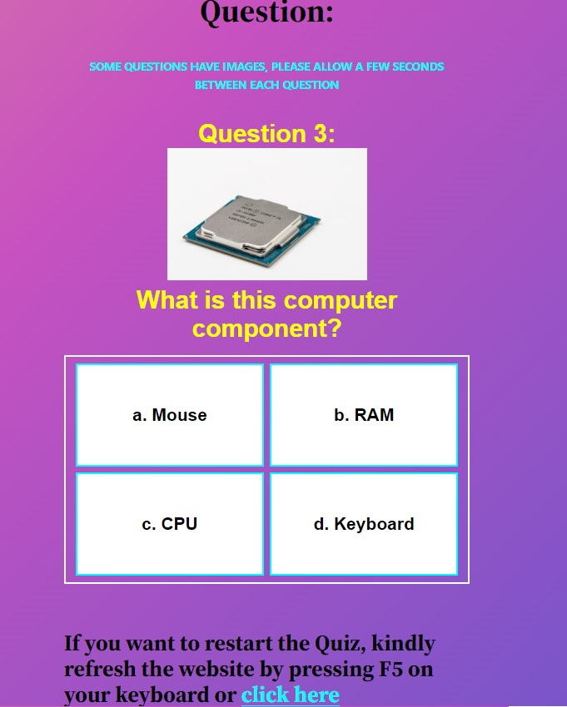
Project plans and methodology (design and implementation)
Adding images to questions
Upload non-copyright images to image hosting site and
paste it to the img src
question:”<br><img src=‘https://example.com/xxx/xxx.jpg’>
<br>What is this computer component?”

Slide 23

Project plans and methodology (design and implementation)
Quiz results
Highlighted words “Software” and “Hardware” to direct users
to specific pages.

Slide 24
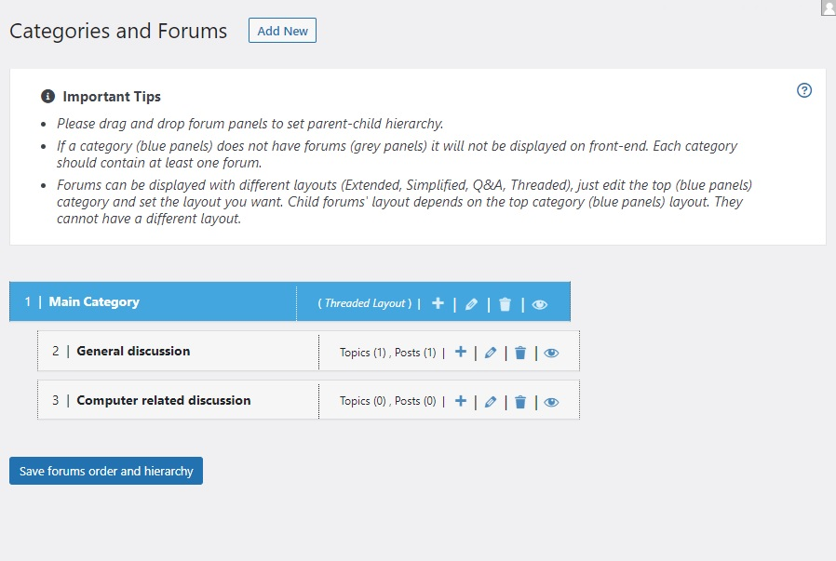
Project plans and methodology (design and implementation)
Adding forum to the website
With WordPress plugin, “wpForo”

Slide 25
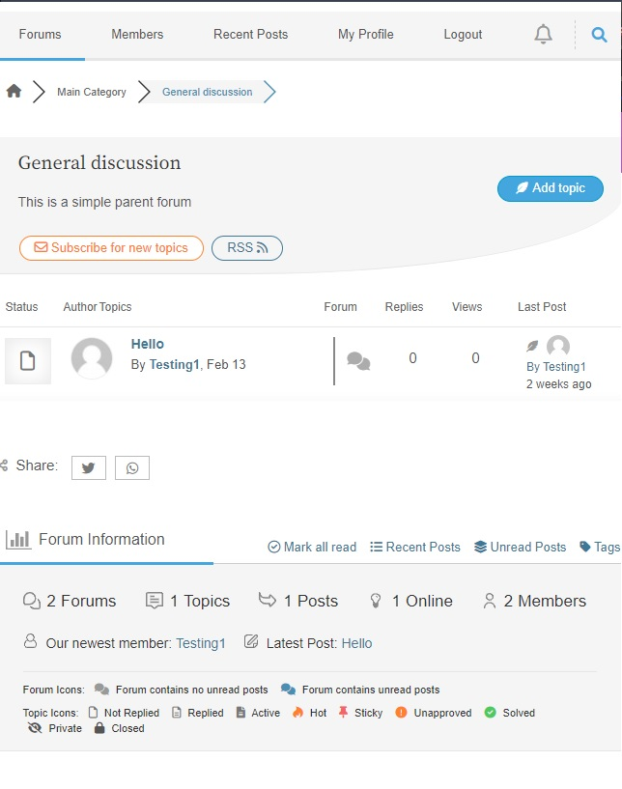
Project plans and methodology (design and implementation)
Interface of the forum

Slide 26
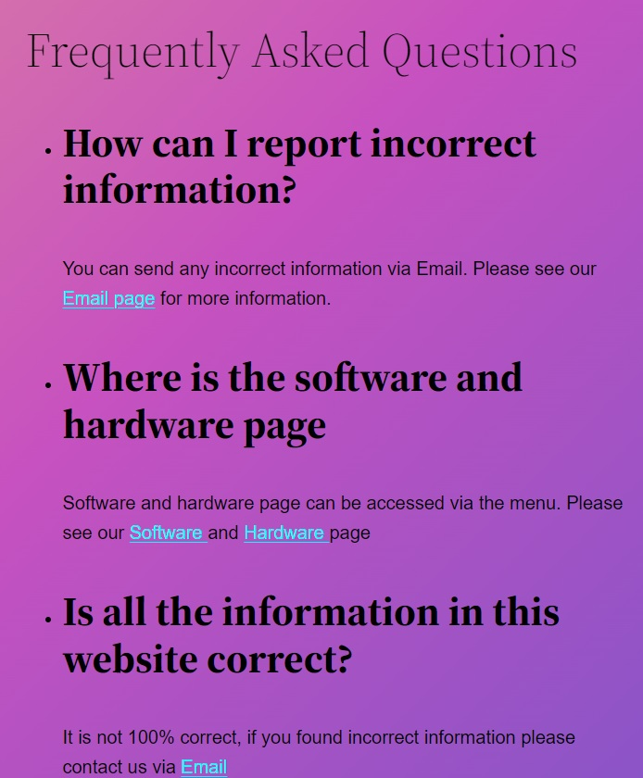
Project plans and methodology (design and implementation)
FAQs

Slide 27
Project plans and methodology (design and implementation)
Pages on the website
About us
Software
Hardware
Computer
FAQs
Forum
Quiz

Slide 28
Project plans and methodology (Testing)
Access the website with different devices from me and my friends
Testing on the website performance and load time with different tools

Slide 29
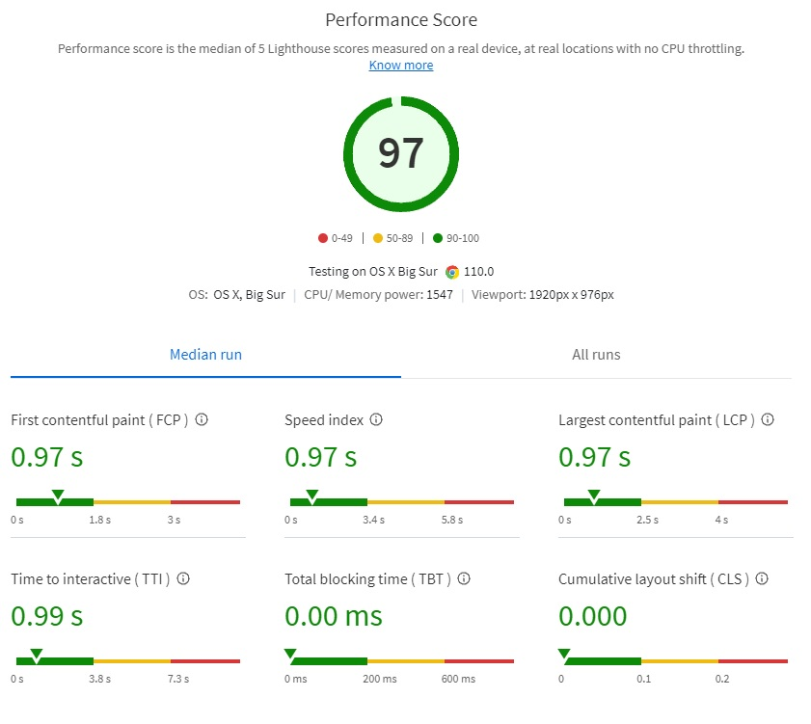
Project plans and methodology (Testing)
Result from SpeedLab

Slide 30
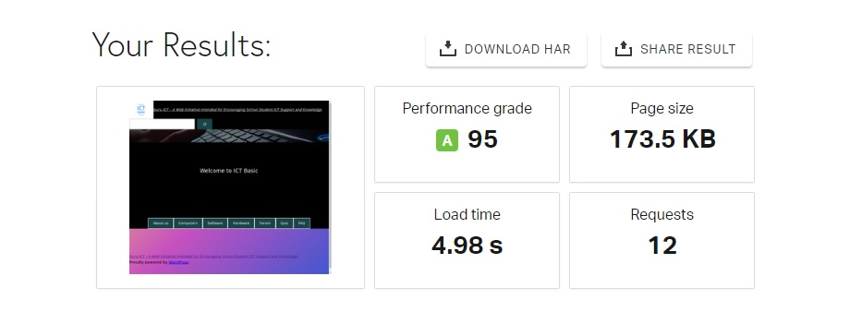
Project plans and methodology (Testing)
Result from Pingdom Speed test

Slide 31
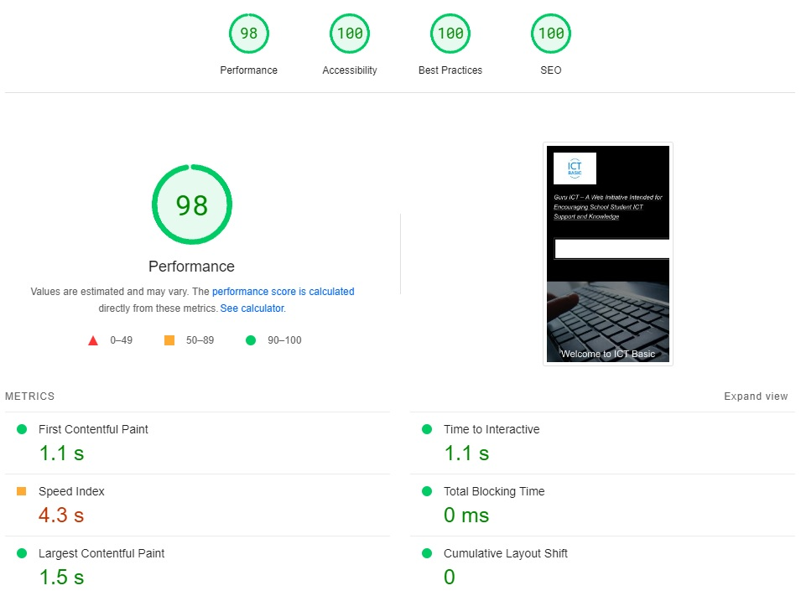
Project plans and methodology (Testing)
Result from Google PageSpeed

Slide 32
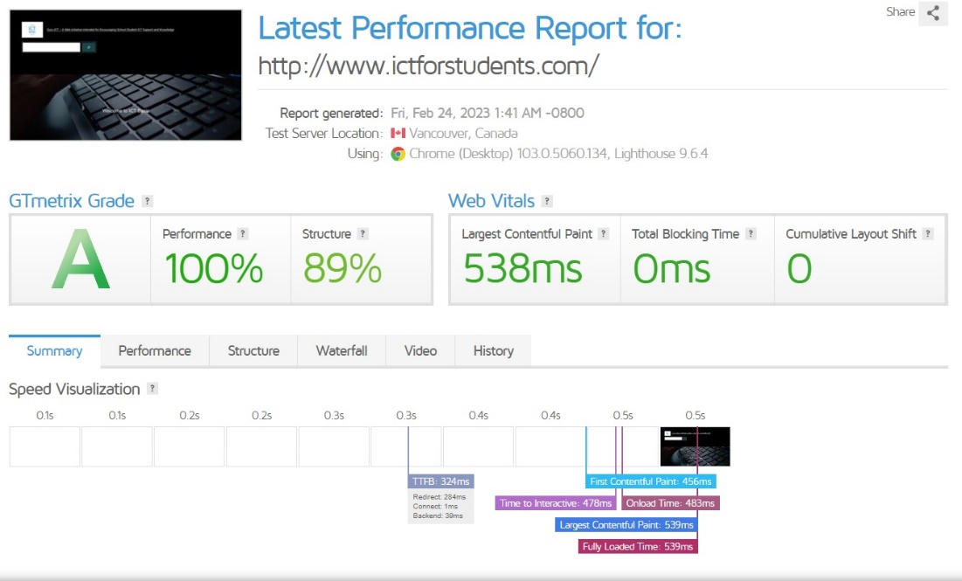
Project plans and methodology (Testing)
Result from GTmetrix

Slide 33
Project plans and methodology (Maintenance)
Security services by Nightmare Labs of DreamHost
Keep WordPress plugins up-to-date manually
Frequent checking on the performance of the website
Understand every update note and update whatever it is necessary

Slide 34
Conclusion

Slide 35
Future improvements
Design
Information
Features and functions
Hosting alternatives

Slide 36
Lessons learnt
Importance of planning
Use of WordPress for website development
Experience in using HTML, JavaScript and CSS to create and arrange different functions to insert into WordPress for the website
Understand User experience
Understand testing, optimization and continuous improvement

